Slide 1
Prenatal Outreach Representative Program
Developing Your Medical Outreach Plan

Slide 2
Know the Numbers
Determine the # of births of babies in the counties you serve
Divide that number by 800 to find out the anticipated # of babies with Ds in your region
Determine the number of babies referred to your organization annually.
Look at the Vital Statistic through the county or state
Determine your percent capture rate.

Slide 3
Determine the contents of packets for providers and parents
Notes:
I can tell you that creating balanced resources is hard work to meet the needs of patients and navigate between the different stakeholders, but it is possible. Our program is part of the University of Kentucky’s Human Development Institute, which is a University Center for Excellence in Developmental Disabilities. This allows us to act as a middle ground between the different stakeholders, and as a university program, we’ve created a a rigorous academic editorial process to do this work.
We’ve constructed a checklist and template based on the research about the needs of patients and providers following a diagnosis.
We conduct a Literature Review of research about the different conditions, including psychosocial research. And in the cases of some rarer conditions, we end up having to do the quality of life psychosocial research if it has never been done before.
Once we create a draft, we submit it to the Genetic Conditions Consensus Group we have assembled that includes representatives of ACOG, ACMG, NSGC, AAP, the Association of University Centers on Disabilities, and national patient advocacy groups for each condition.
We undergo at least 2-3 edits with those representatives while at the same time organizing photo shoots that include a diverse representation of people with each condition. All of the photos are taken on location to reflect the interests and capabilities of the individuals.
We then undergo edits to reduce the grade level of the content—the hardest part, go through a final copy edit and submit the final version to all the respective organizations.
Once the final form is confirmed, we release the content in print form, as a web app, and then we translate as we have the funds to do it. Down syndrome is currently available in 9 languages and recommended by NIH HealthReach.
We also disseminate the materials through direct mail and email, state public health departments, and collaborations with medical and patient advocacy organizations and some labs. All of our materials are available free online, and people can also request limited quantities of free printed materials as needed and through some state departments of public health.
We started this process with Down syndrome and then replicated it for Turner and Jacobsen syndrome, so we know it works,

Slide 4
Prenatal Pre-Decision/ “First Diagnosis” Packets for Parents
Lettercase Understanding a Down Syndrome Diagnosis
If you are prepared to support pre-decision parents at this time: Letter/cards/brochure for expectant parents about what your organization can offer them.
If not prepared for pre-decision support, request National Prenatal First Call Brochure
Your Organization Brochure
Provide one packet per OB office you plan to serve and 3-10 per MFM or CGC depending on the birth numbers in your area)

Slide 5
Prenatal Packets for Provider
Lettercase Understanding a Down Syndrome Diagnosis
NDSAN Adoption Brochure
Lettercase Delivering a Prenatal or Postnatal Diagnosis
DSDN Delivering a Prenatal Down Syndrome Diagnosis
Letter from your organization about what you offer new and expectant parents and providers
State Information Act?
Lettercase Understanding Prenatal Screening and Testing for Chromosome Conditions
Provide one per medical professional you plan to serve.
Your organization brochure
DSDN Delivering a Postnatal Down Syndrome Diagnosis

Slide 6
Prenatal “Preparing for the Journey” Packets for Parents
Diagnosis to Delivery: A Pregnant Mother's Guide to Down Syndrome (follow-up visit or basket)
Letter/cards/brochure for new and expectant parents about what your organization can offer them.
DSDN Brochure
Explain to providers that these are additional materials for families who are preparing for the birth of their baby and want more information in a follow-up visit.
Other Resources/Books/Gifts or Expectant Parent Baskets
Your Loved One Is Having a Baby with Down Syndrome
Lettercase Brochure
National First Call Brochure, if an organization needs extra support

Slide 7
New Parent Packets
Welcoming a Newborn with Down Syndrome
Letter/cards/brochure for new and expectant parents about what your organization can offer them.
DSDN Brochure
Other Resources/Books/Gifts or Expectant Parent Baskets
Breastfeeding and Down Syndrome
Congratulations Project
Lettercase/Down Syndrome Pregnancy Brochure

Slide 8
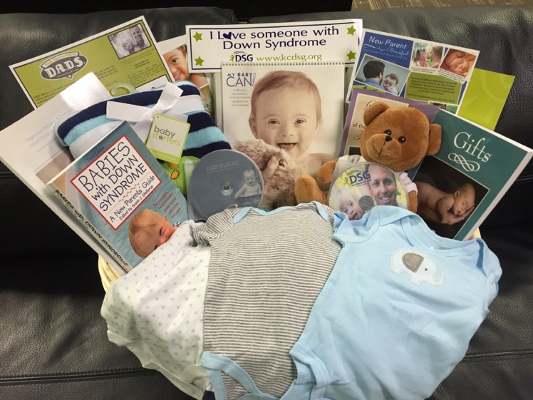
Baskets for New Parents
Baskets may contain many resources and gifts to welcome new parents or expectant parents preparing for the journey. We have many organizations who can provide examples in Prenatal Outreach Program Facebook group and IDMTF email.
Jack’s Basket is another great resource you can utilize.

Slide 9
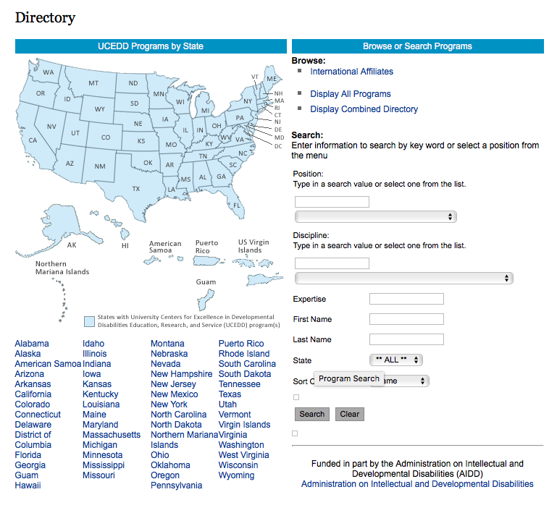
Closest UCEDD as a source of interns and host for seminars
https://www.aucd.org//template/index.cfm

Slide 10
Identify Maternal Fetal Medicine Specialists and Genetic Counselors who serve your region
https://www.nsgc.org/page/find-a-genetic-counselor
https://www.smfm.org/members/search
https://clinics.acmg.net

Slide 11
Identify and connect with the largest birthing hospitals in your area
Connect with perinatal social worker
Head nurse at NICU

Slide 12
Understand your Down Syndrome Information Act
https://www.lettercase.org/issues/state-laws/

Slide 13
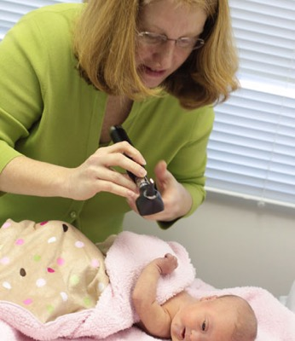
Identify and collaborate with medical allies in your area

Slide 14
Compile a list of all medical providers who could be delivering a diagnosis

Slide 15
Identify if you have a genetic counseling program in your area.
https://www.gceducation.org/program-directory/

Slide 16
Determine how you are tracking data
Excel spreadsheet
Online database
Other tool

Slide 17
Identify if your program will need to train representatives
https://www.lettercase.org/pht-203-prenatal-medical-outreach-training-for-trainees/

Slide 18
Assess your website and branding:
Audience of new and expectant parents
Provider Audience
Branding and name
Provide national resources
List the programs your organization offers new and expectant parents
Provide national resources
Contact information for presentations
Training resources
Convey professionalism

Slide 19
Website Examples
http://dsaco.net/new-parents/
https://www.kcdsg.org/newparents.php
https://mdsc.org/programs/ParentsFirstCall.cfm and name
https://mcdsig.org/category/new-expectant-parents/

Slide 20
Identify resources for multicultural audiences?

Slide 21
Identify 3-5 goals for the next 6 months, including one goal to outreach to a new clinician

Slide 22
The National Center for Prenatal and Postnatal Down Syndrome Resources
Stephanie Meredith, MA
stephaniem@lettercase.org
facebook.com/lettercaseorg
twitter.com/lettercaseorg
twitter.com/DownSynPreg
downsyndromediagnosis.org

